Slide 1

A11Y TESTING
Accessibility
2023
JAMAL FOX

Slide 2

TABLE OF
CONTENTS
01
Design / UX
03
Manual
Analysis of design elements for usability and accessibility.
Involves deliberate review of code for WCAG adherence.
02
Automated
04
AT / User
Programs that scan web page for low-hanging fruit and a11y improvements.
Involves AT to gain an accurate measure of usability for visitors with disabilities.
There are 4 primary ways to test for accessibility. Each with their own challenges and benefits.

Slide 3



Design / UX
FOUNDATIONS FOR DEVELOPMENT
Designers evaluate sketches/mockups/designs for usability and accessibility.
STRONG BASIS FOR DEVELOPMENT
CATCH VULNERABILITIES/PITFALLS EARLY
DIFFICULT TO REPEAT AT ALL STAGES OF SDLC
REQUIRES ACCESSIBILITY KNOWLEDGE

Slide 4





TESTING COVERS
Color Contrast
Typography
Design / UX testing spans an array of topics and checks. Here are a few popular ones.
Are icons and text visible in all states?
Is text readable for average users? Can the interface accommodate larger browser text?
Form Fields
Images
How do various form states look? Required? Error? Success? Do they all meet contrast?
Do images have defined and relevant alt text?

Slide 5

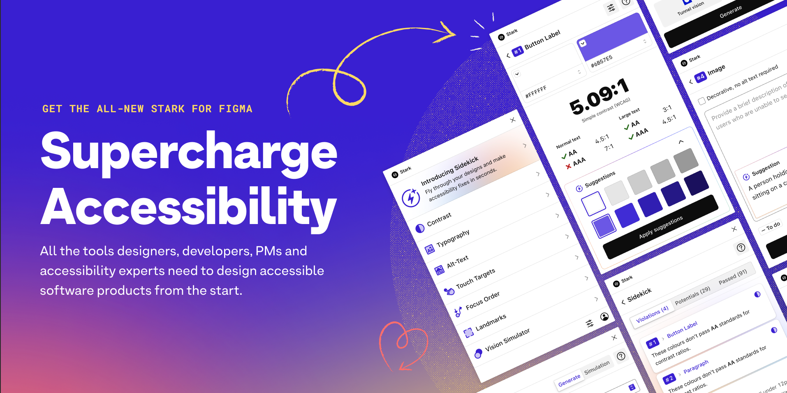



Testing Tools
A11y Contrast Checker
Plugin that checks elements in selected frame for AA and AAA contrast
Text Resizer
Plugin that shows Figma frames/elements at various font sizes
Cards for Humanity
Persona generator to drive accessibility considerations.
Stark
All in One Figma plugin for accessibility

Slide 6
Automated
CONTINUOUS CONSIDERATION
Plugins / extensions are used to programmatically scan site for accessibility pitfalls and vulnerabilities
EASY TO RUN AT ALL STAGES OF SDLC
REQUIRES LITTLE ACCESSIBILITY KNOWLEDGE
DOES NOT CATCH ALL ERRORS

Slide 7



WHAT CAN BE AUTOMATED?
Automated checkers can't catch everything, but they're really efficient at what they can catch.
Color contrast on solid backgrounds
Color contrast on gradient/image backgrounds
Image alt text
Relevance of image alt text
Existence of headings, lists, and landmarks
Accuracy of headings, lists, and landmarks
Aria elements are present on native controls
Aria usage on custom controls

Slide 8





AUTOMATED TESTING
These chrome extensions are easy to run and clear to implement
Lighthouse
Axe
Stark
Bult in chrome dev tool
Deque chrome extension
Cross-browser extension

Slide 9


MANUAL
TESTING
Involves the manual review of HTML, CSS, and JavaScript for A11y errors / mistakes
Can sometimes be assisted with AI plugins. VS Code has a few that are helpful, but they often have the same limitations as automated checkers.
CATCHES ACCESSIBILITY ERRORS CHECKERS CAN'T
CAN BE COMPLE AND TIME CONSUMING
Can be time consuming and complicated, so it isn't easy to integrate throughout the SDLC
HARD TO REPLICATE AT DIFFERENT STAGES OF SDLC
REQUIRES EXTENSIVE ACCESSIBILITY KNOWLEDGE

Slide 10




AT / USER TESTING

Slide 11

THANK YOU

